Slide 1

Smart Solutions for a Sustainable Saint Petersburg
Nodiri Khusrav

Slide 2
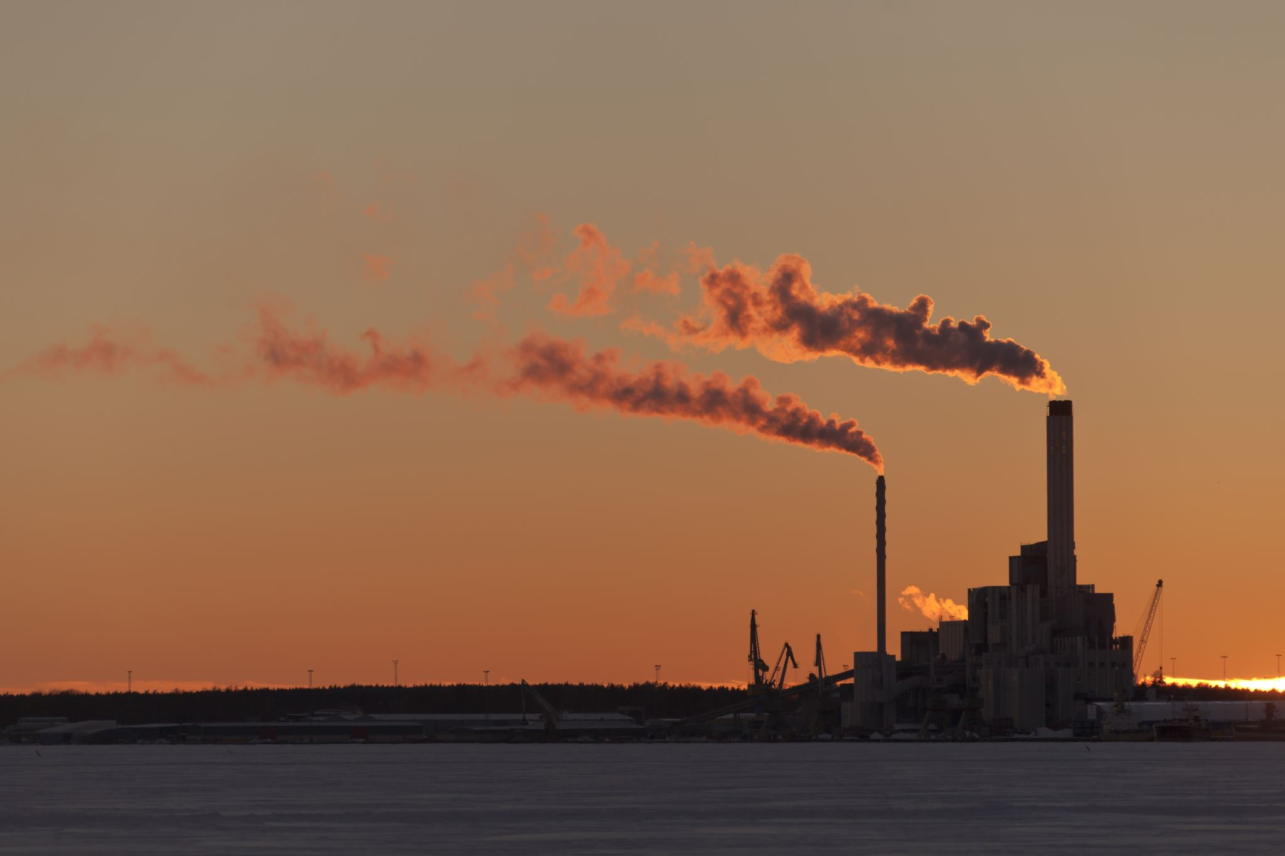
Air pollution
Air pollution is when harmful substances mix with the air we breathe. It can be caused by different things like cars, factories, and power plants. These substances can make people sick, harm animals, plants, and even buildings. In cities, air pollution is usually worse because there are more cars and factories.
PM2.5 -> 4 µg/m³

Slide 3

Air pollution
Air pollution happens when unwanted chemicals or other materials get into the air. It can come from natural sources like volcanoes or forest fires, but most of it comes from human activities such as:
Cars and Trucks
Factories and Power Plants
Construction and Agriculture
Household Products

Slide 4
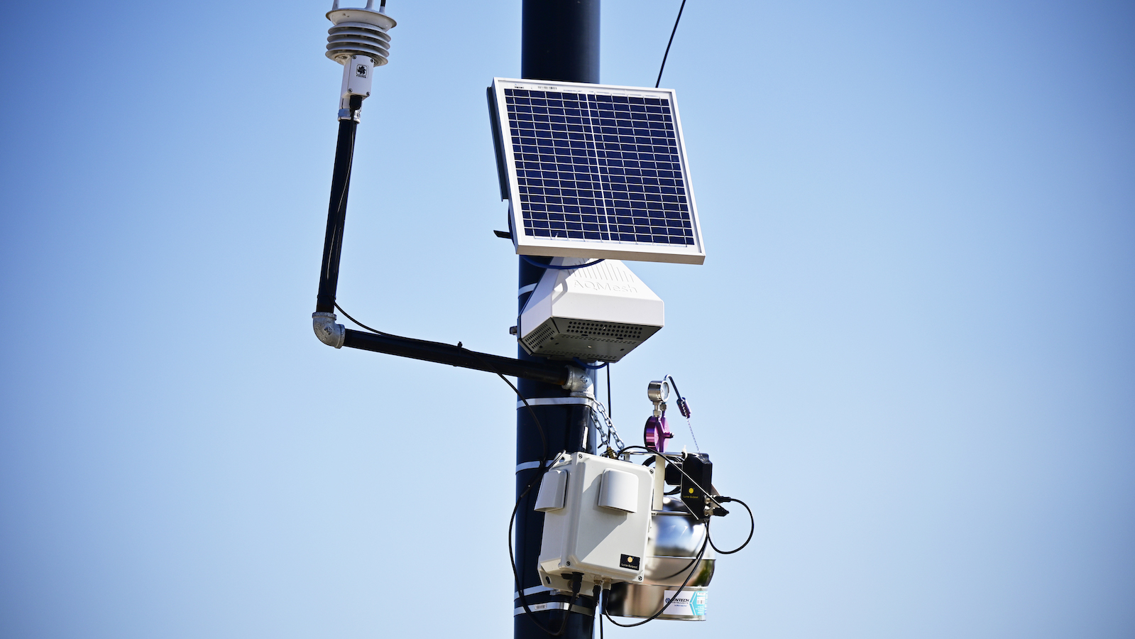
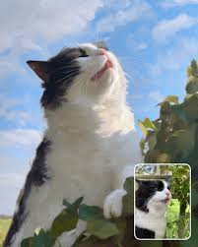
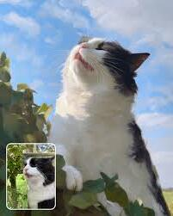
network of IoT sensors
Implementing a network of IoT sensors throughout Saint Petersburg can help monitor pollution levels in real-time.

Slide 5
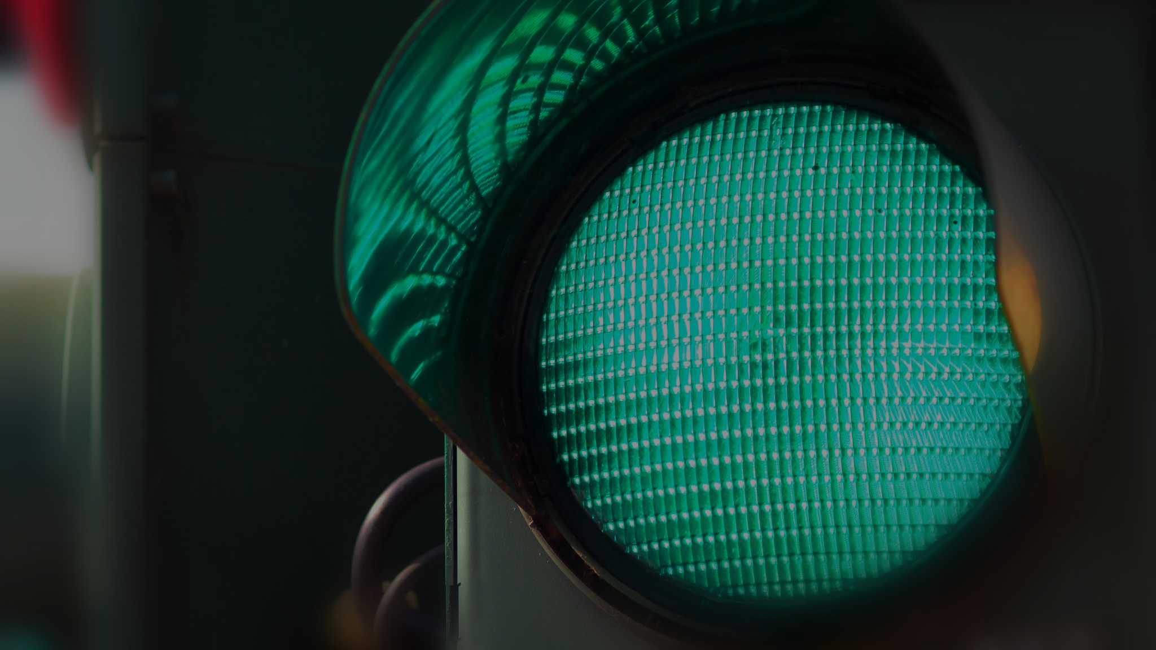
Traffic Management
Another major issue in Saint-Petersburg is traffic congestion, which leads to increased pollution and valuable time lost.

Slide 6
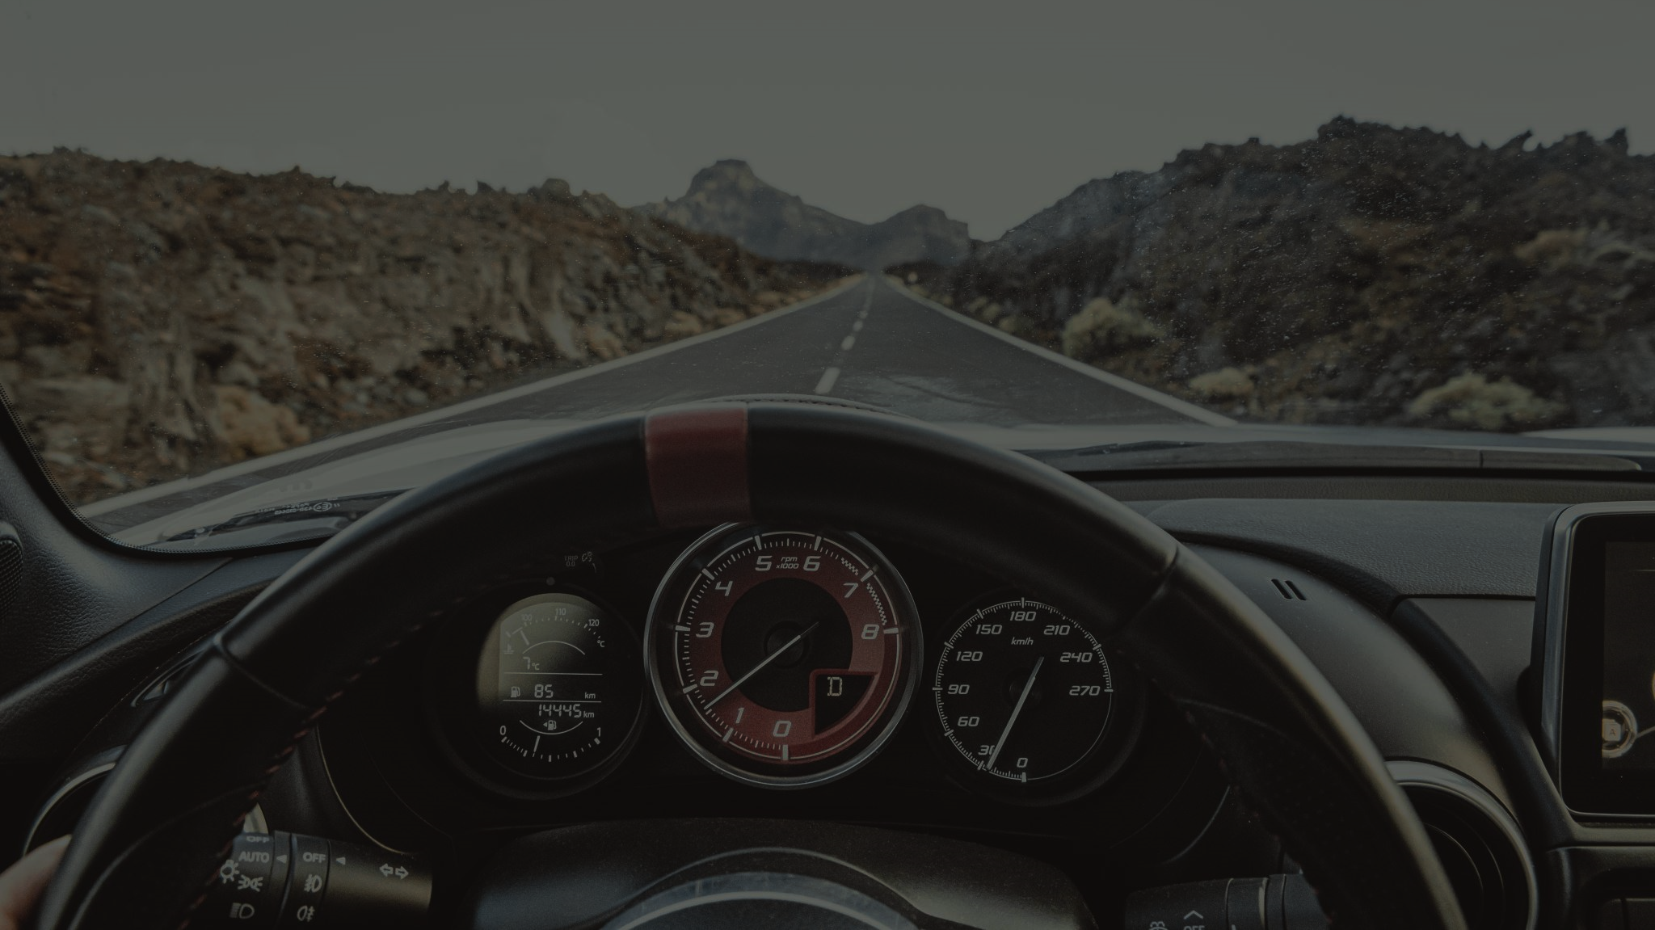
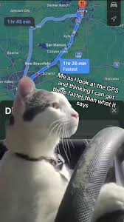
Traffic management
To solve traffic jams, one effective solution is to integrate real-time traffic light data into navigation apps like Google Maps.

Slide 7

Thank you for your attention

